Slide 1
Wearable Application
Battery-Saving Compression Techniques
By Michael Harootoonyan
Email: michael.harootoonyan.535@my.csun.edu

Slide 2
Introduction
Consider a wearable application that collects sensor data by writing it into a text file and then transferring that data over to a mobile device after a certain amount of sensor data is collected. Imagine that the app remains powered on all day and multiple transfers occur throughout the day. These data transfers between the wearable and mobile device will then contribute to one of the main battery syncs in wearable applications.

Slide 3

Investigation
I investigated the relationship between data compression and battery performance when passing data from wearable devices and mobile devices.

Slide 4
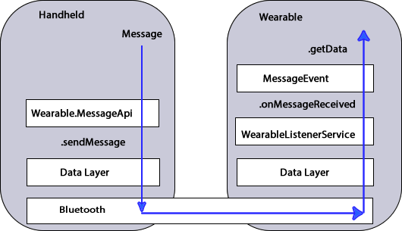
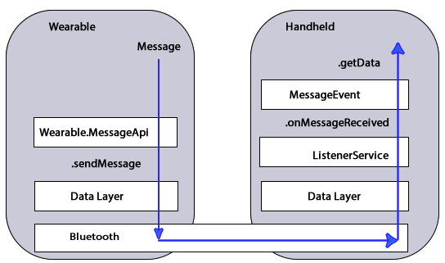
Two Systems were Developed for the Investigation
Mobile Device to Wearable Device Wearable Device to Mobile Device

Slide 5
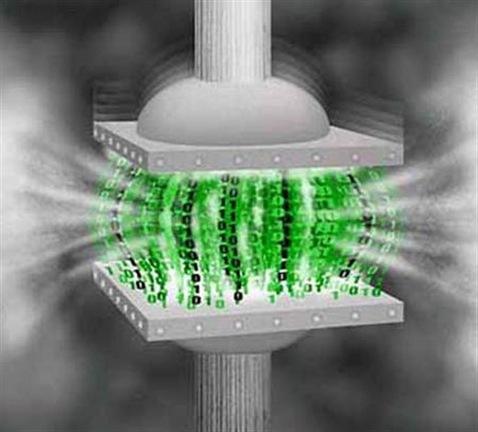
What was developed?
In each system, there were two applications developed. In both systems, Application A involves using a lossless data compression algorithm to compress the data before transferring it over through bluetooth. The data is then decoded on the device that received it to be read by the user.

Slide 6
What was developed? (continued)
In both systems, Application B did not use a compression algorithm on the data before transferring it over through bluetooth. The data was sent uncompressed.

Slide 7
Testing & Data
Transferring data from the
wearable device to the
handheld device.

Slide 8
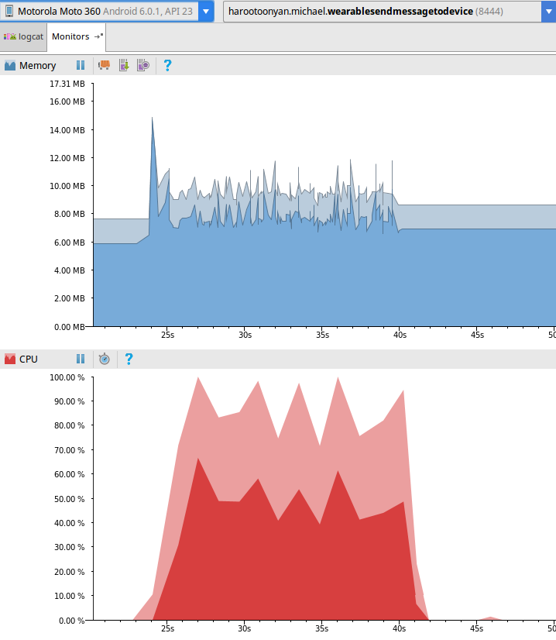
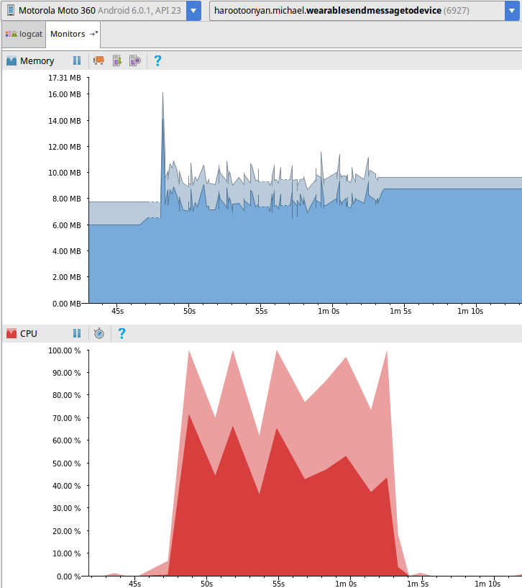
Testing and Data
Compressed Uncompressed

Slide 9
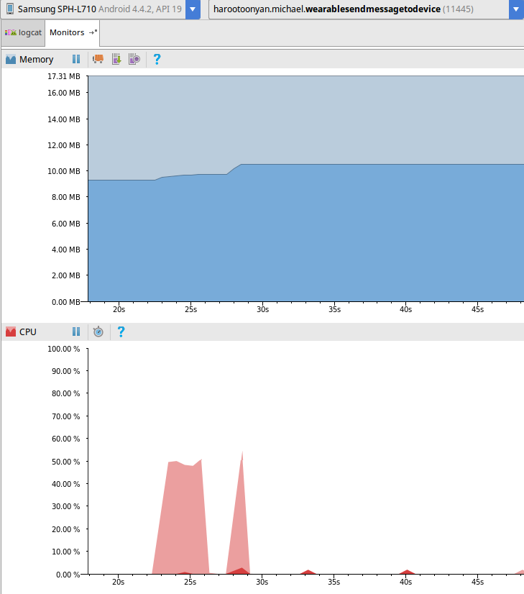
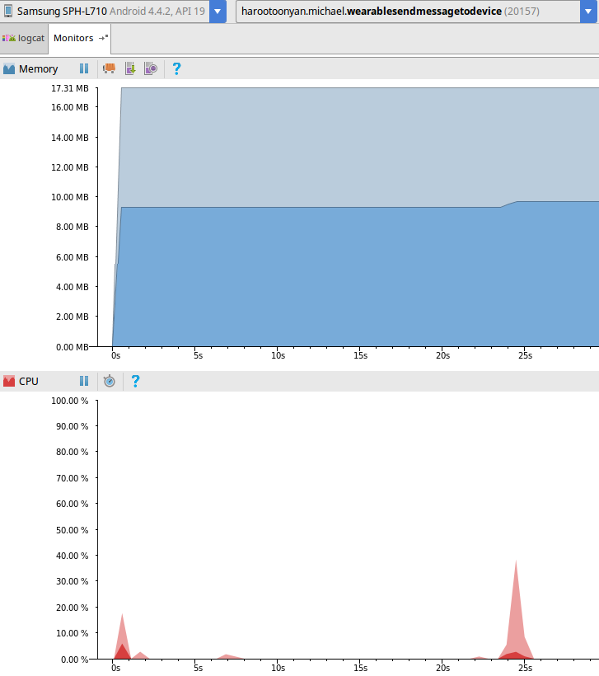
Testing and Data
Compressed Uncompressed

Slide 10
Testing & Data
Transferring data from the
handheld device to the
wearable device.

Slide 11
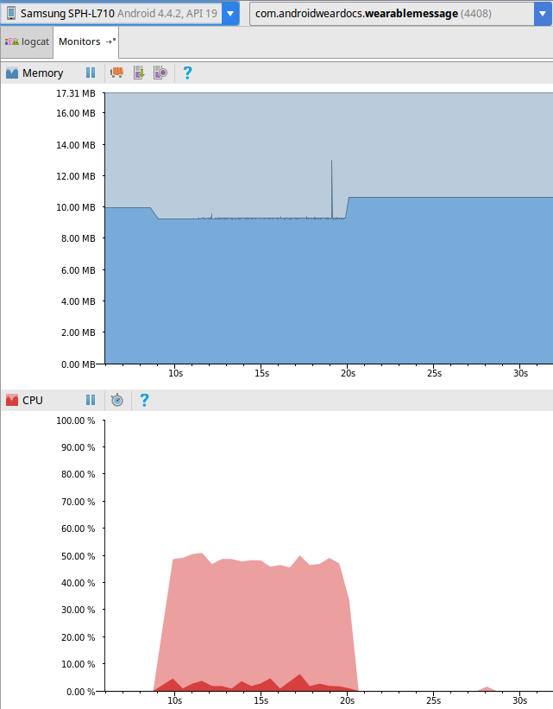
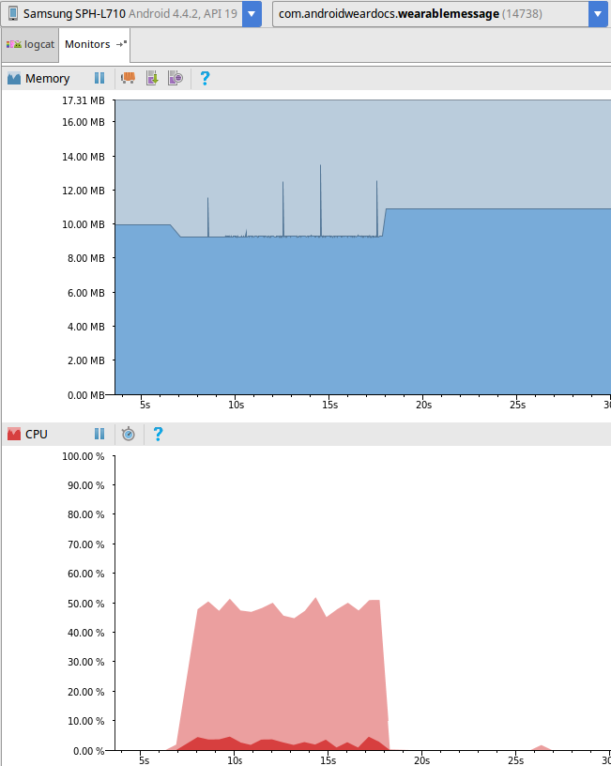
Testing and Data
Compressed Uncompressed

Slide 12
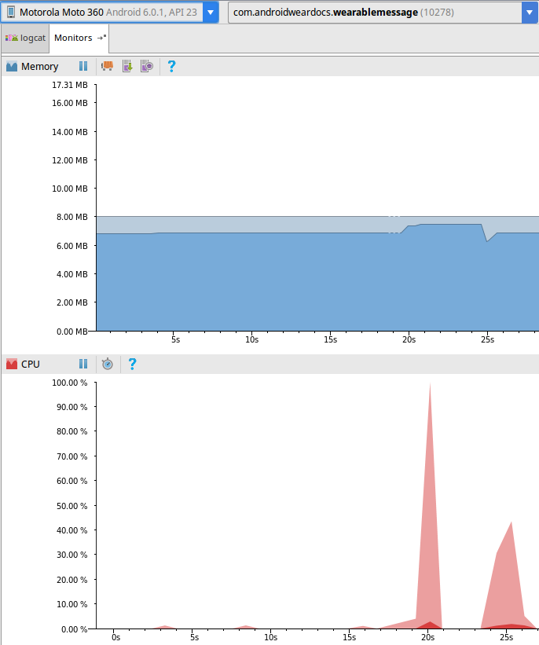
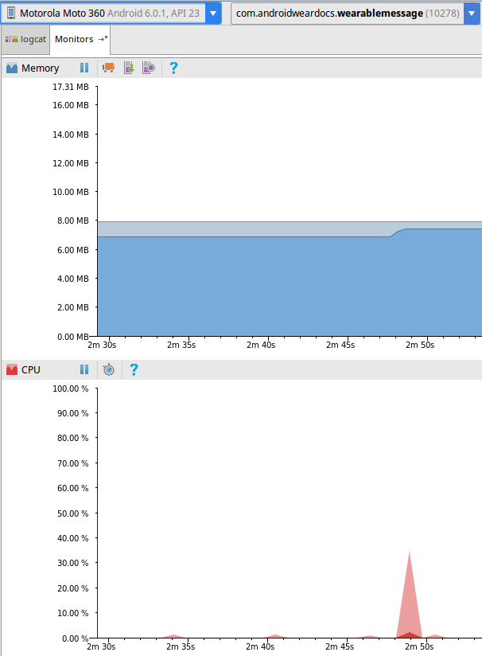
Testing and Data
Compressed Uncompressed

Slide 13
What has been left to future work?
From the results you can see in both systems that applications A and B have very similar trend lines when sending the data. Future work involves developing automated versions of the applications A and B, so that the data can be sent out regularly. Having the the programs run for some period of time and then using the Battery Historian to see the battery sync in the long run.

Slide 14
Lessons learned
Using the application Power Tutor on the mobile device was not an accurate way to collect battery consumption.
Using the Battery Historian to measure battery consumption is only good for long term results.
Collect lots of test data to confirm your results and get a better understanding.
Be sure to have controlled tests to gather consistent data.

